Slide 1
Review of Homework
Comments:
Small sample size problems are not as easy as they might first appear. Automodel will not work with n < 100. Plus small samples can be deceptive. Random forest revealed some potential risks of using small samples.
How to Validate models with Small sample size—K Fold Validation
“Project” (an ID) was not a valid X Variable, yet had a large impact on model. Do not accept Rapidminer’s recommendations automatically.
Consider using “weights” operator for variable importance.
Text Classification , make sure that you remove dependent variable from predictors, otherwise accuracy becomes inflated. Example “Cancel”.
Feature Engineering for Text is very important.

Slide 2
Important Reminder
Project Assignment and all Homework Due by 8:00 PM Sunday, May 24th.
Note: Use the Project Files Provided in Week 5.

Slide 3
Homework Question 1

Slide 4
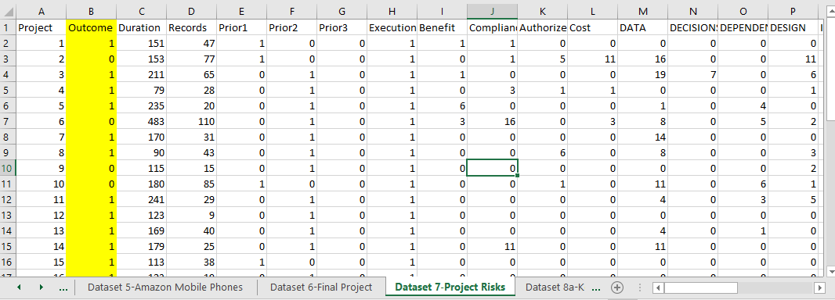
Target Label Representing Project Outcome success or Failure
(0 to 1)
Latent/Predictor Variables Based Upon Frequency of Mentions From Weekly Surveys Conducted during Projects
No Value

Slide 5
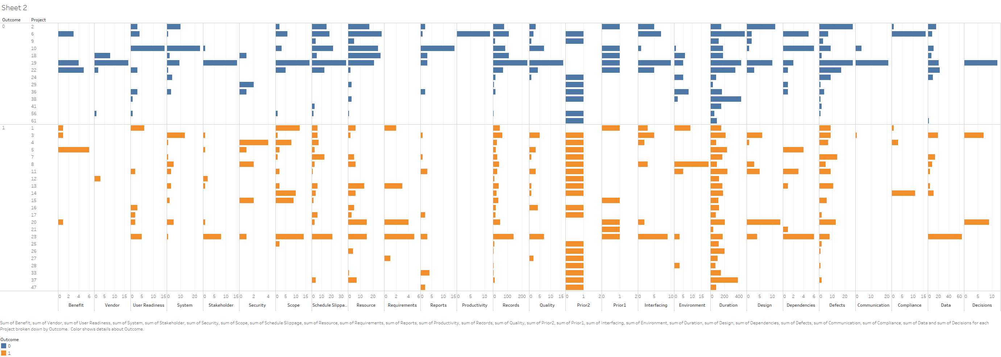
Outcome is the Dependent Variable
(0 or 1)
Tableau Visual Display of the Dataset By Project Classification Success (1) or Non-Success (0)
This Suggests Each Project Carries Its Own Risk Signature. In our sample of projects Certain risks carry more importance than others as shown in the Above analysis
Days 45= 1 if project completed within 45 days of target baseline and stakeholders generally satisfied, 0 otherwise;

Slide 6
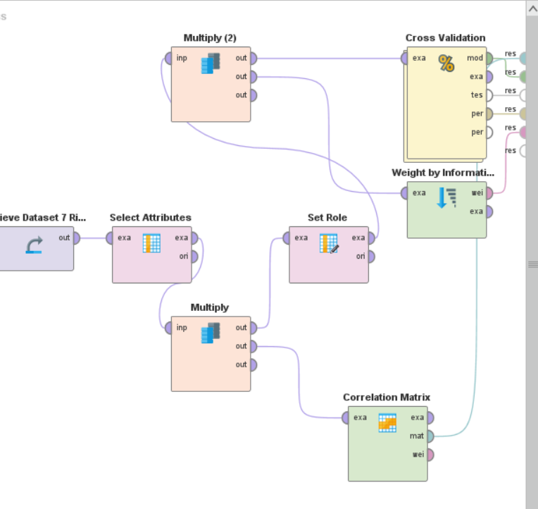
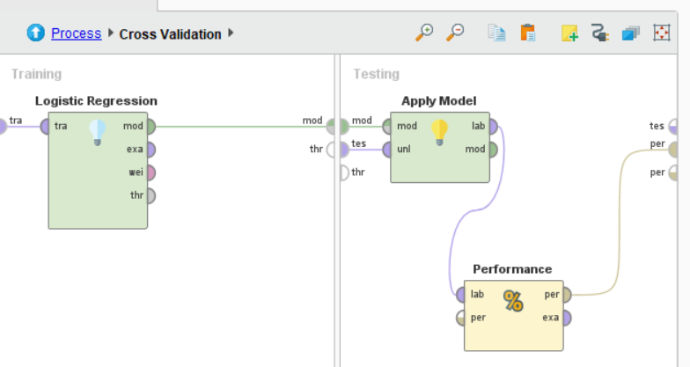

Slide 7
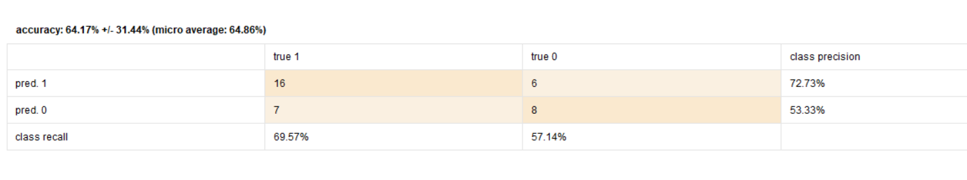
With Cross Validation and Logistic Regression We Get an AUC of .59 Which is Marginal, But We See Our Sample Size Is Small

Slide 8
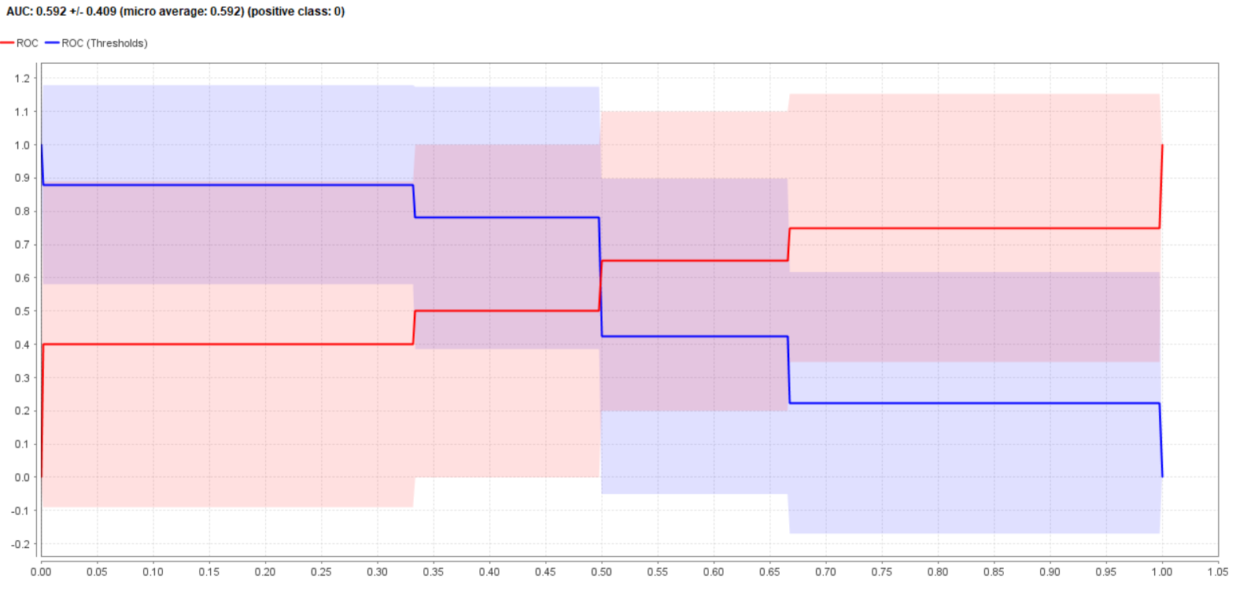

Slide 9
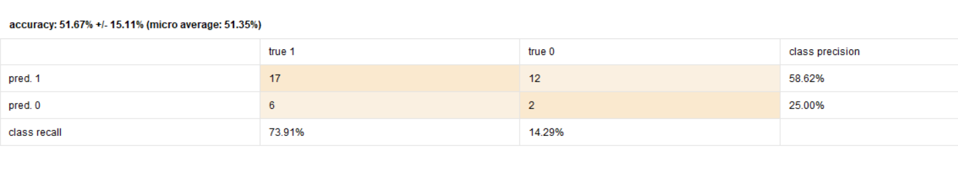
But A Random Forest Model Shows Much Worse Performance

Slide 10
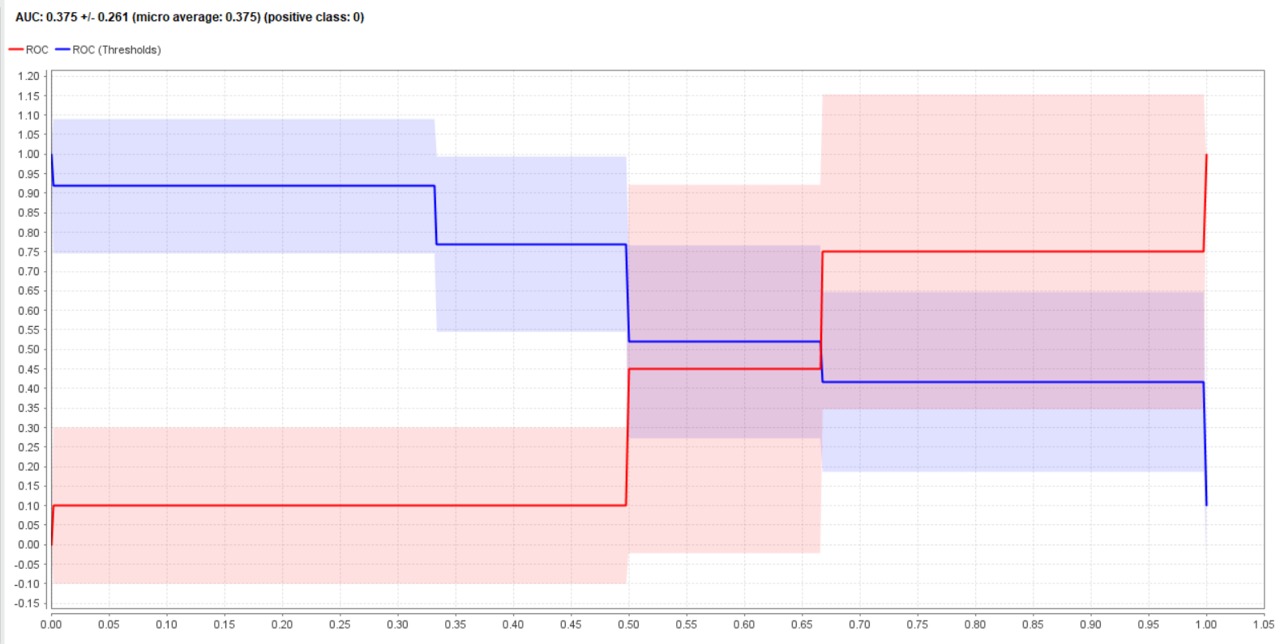

Slide 11
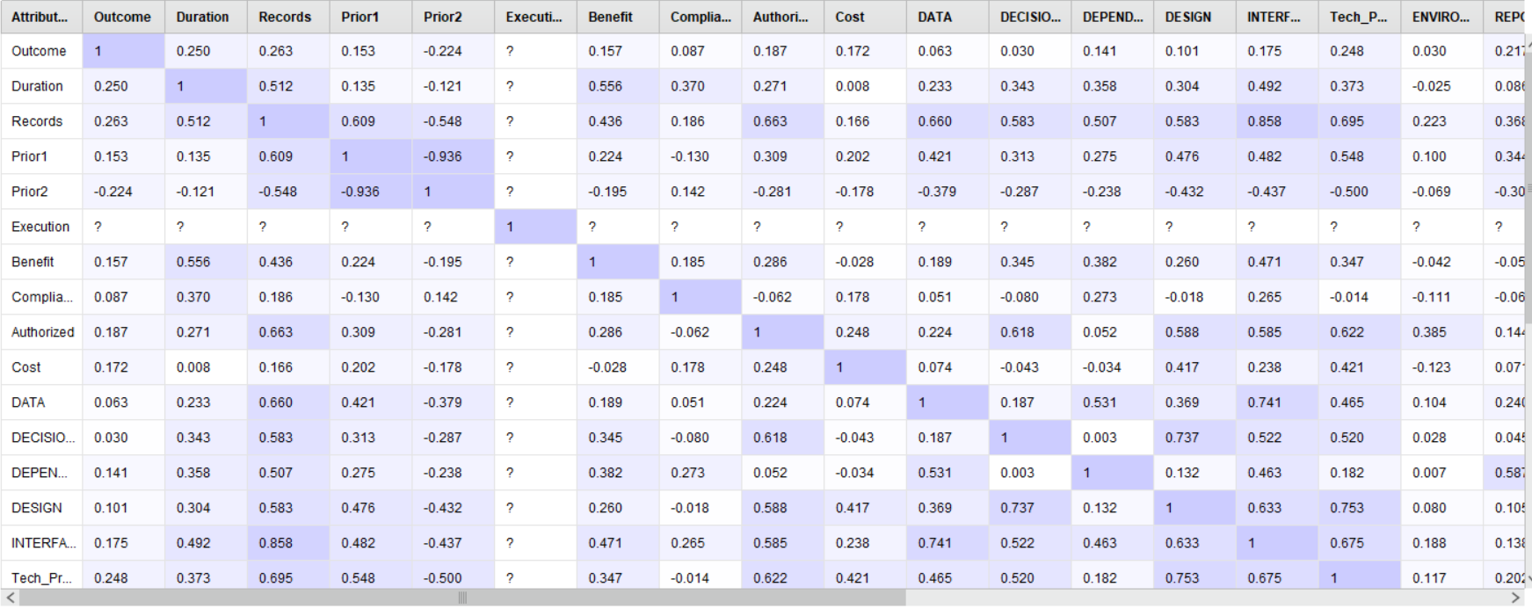

Slide 12
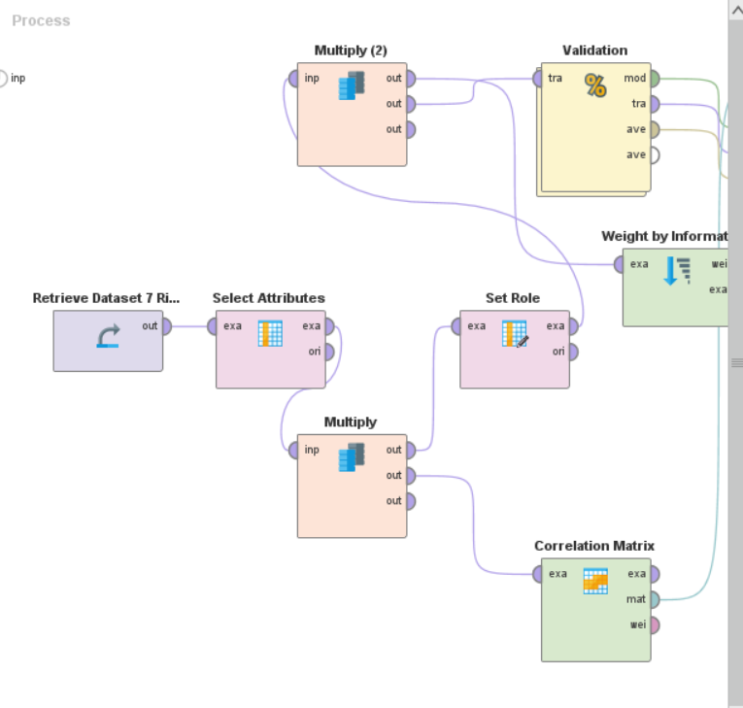
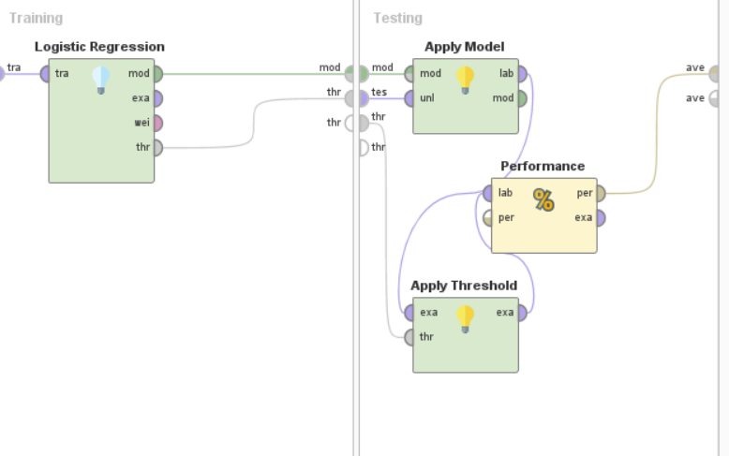
Bootstrap Validation Provides A Clue As to The Differences

Slide 13
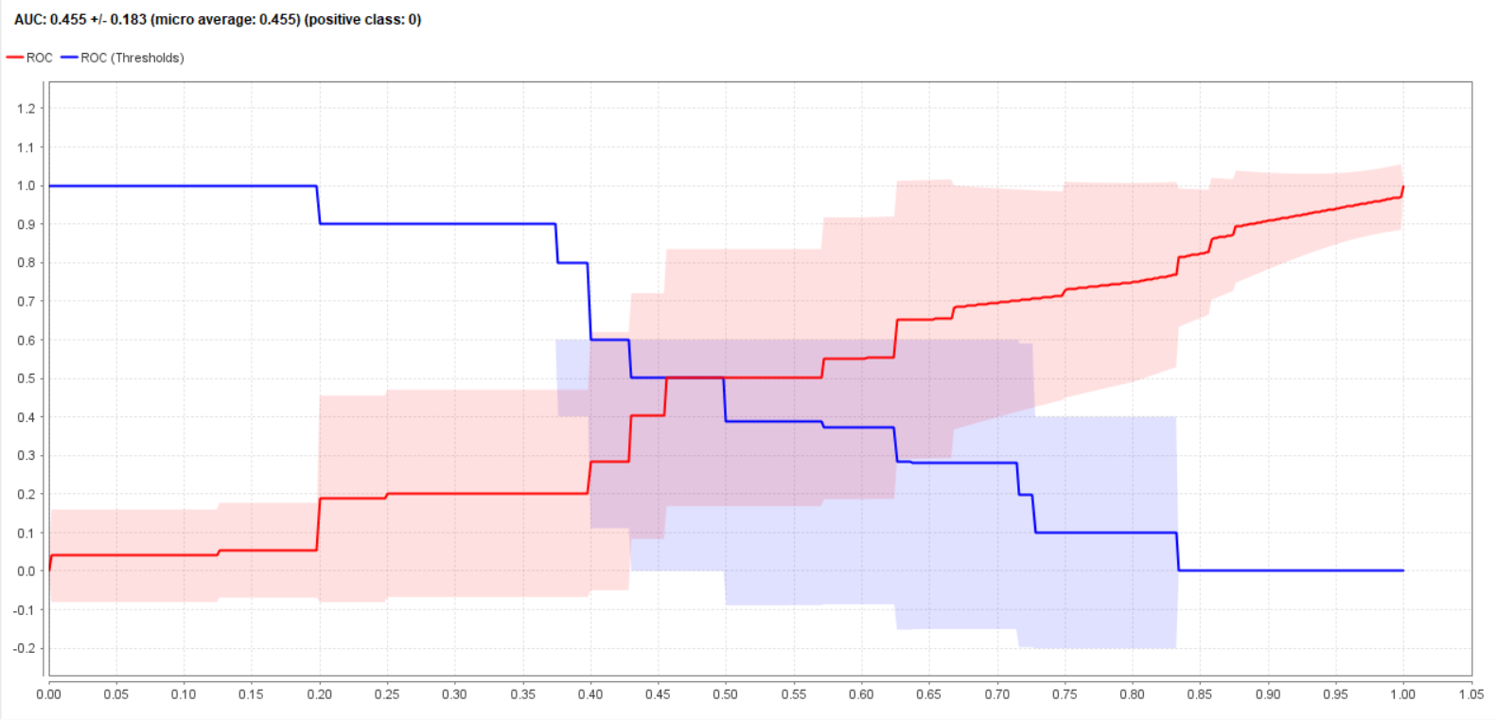

Slide 14
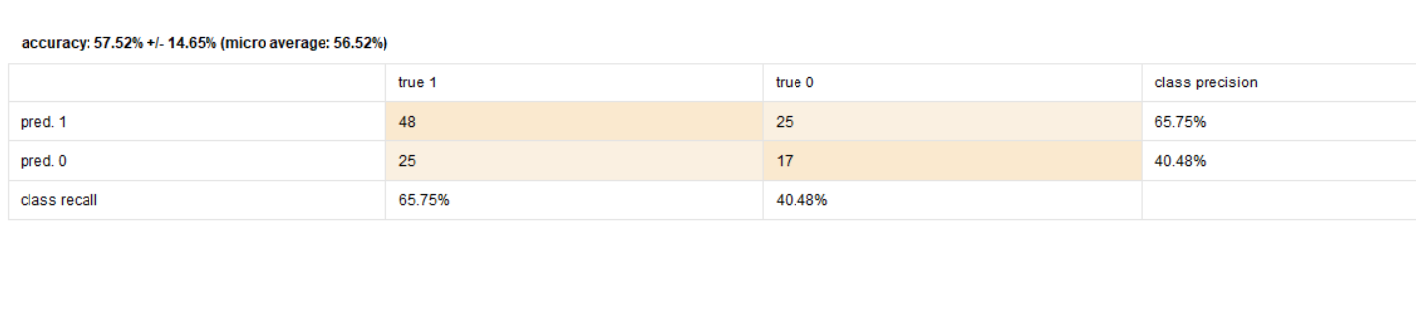

Slide 15
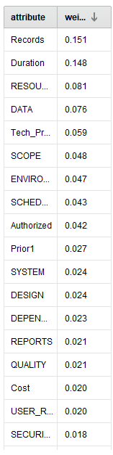
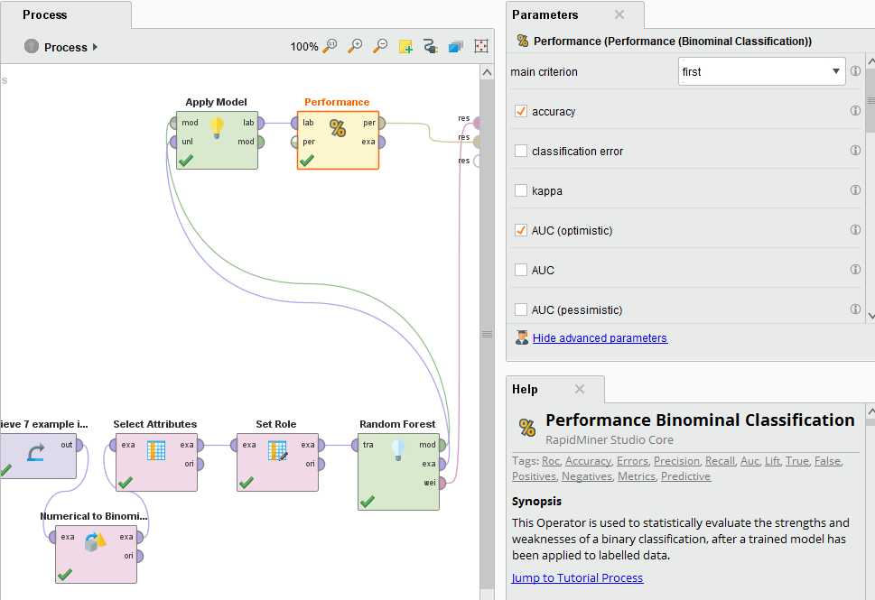
Weights= out of bag which is unique to random forest.

Slide 16
Homework Comcast Text Questions

Slide 17
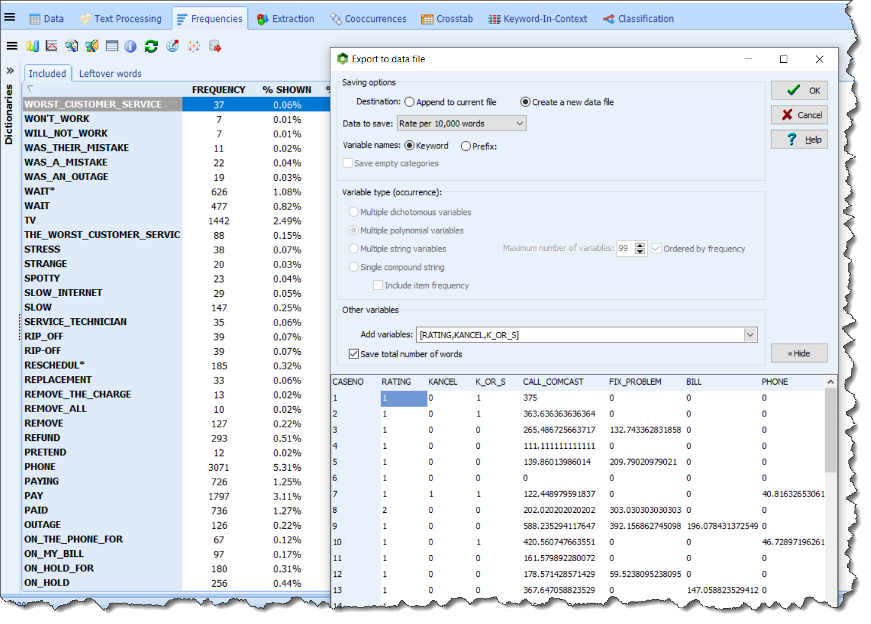

Slide 18
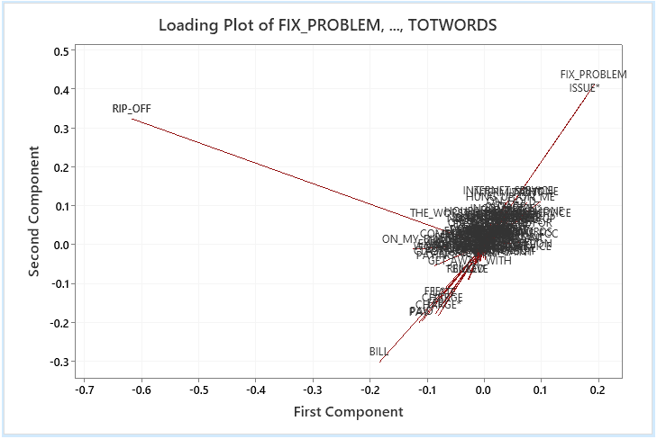

Slide 19
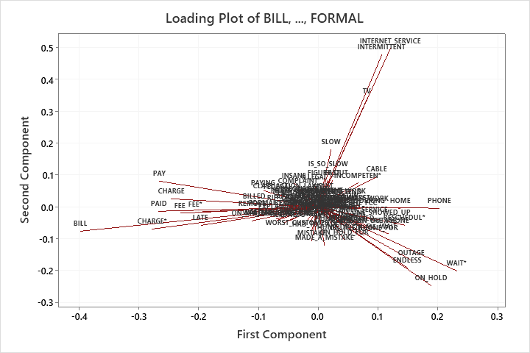

Slide 20
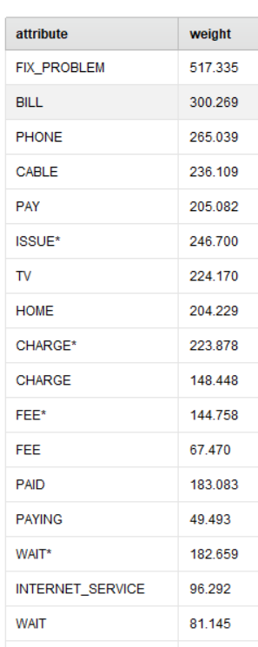
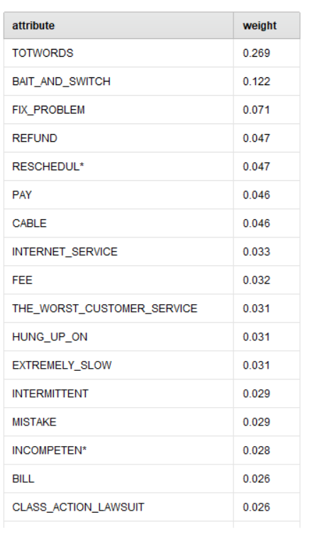
Weight By Gradient Boosted Trees
Weight By Correlation

Slide 21
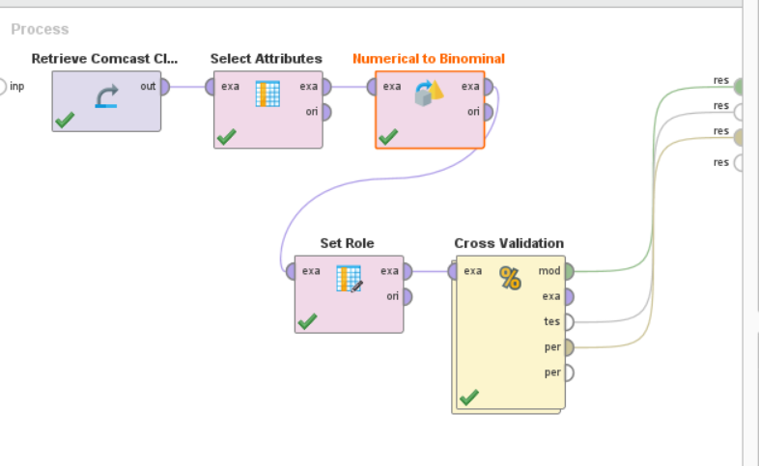

Slide 22
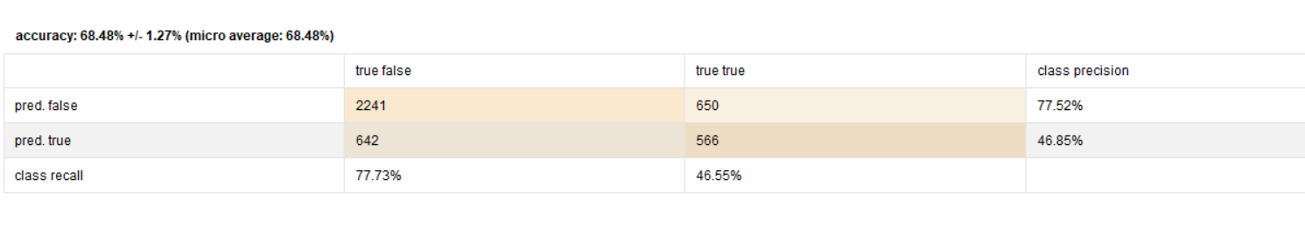

Slide 23
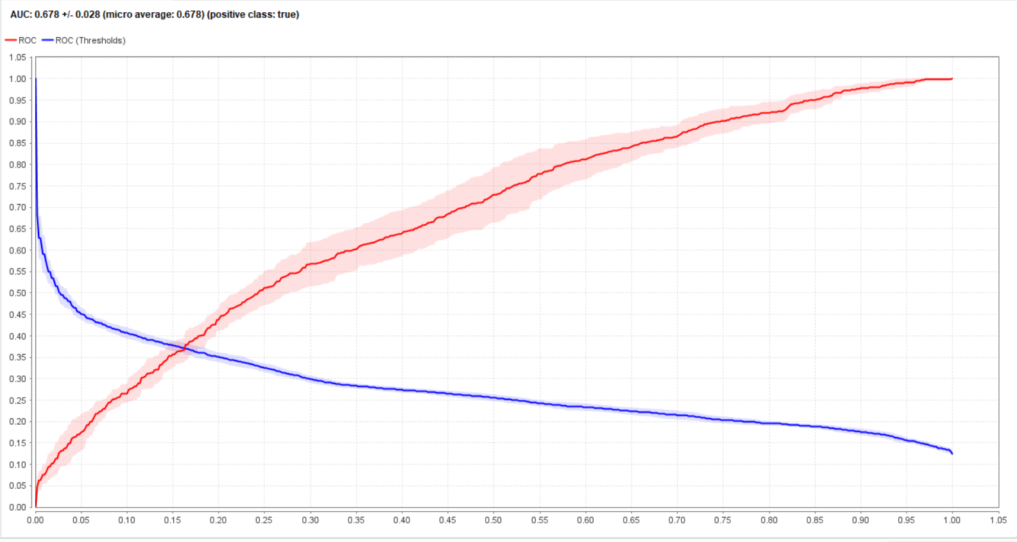

Slide 24
Question 2: Returning to Text Mining
Your Discussion Board was Spot On!

Slide 25
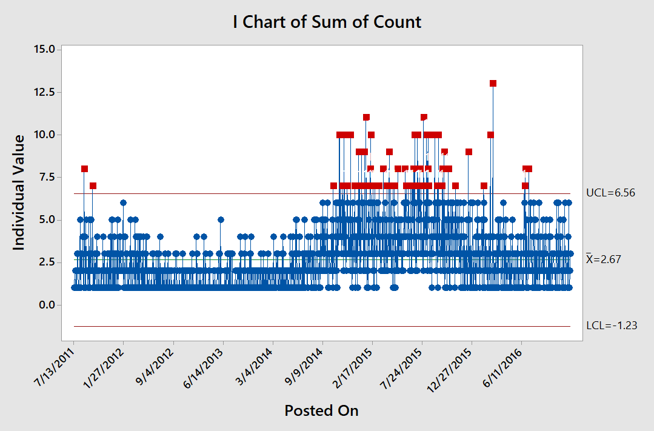
Minitab Graph:
Number of Complaint
Records Posted
Per Day in
Comcast
Dataset Grew
Throughout 2015
The KPI Shows a Period of Difficulty for the Company.
Question arises “How do we solve this problem?”

Slide 26


Modal Salient Beliefs
Witnesses
Sentiment
Cancel
Rude treatment on the phone
Waiting too long on phone
Rescheduling service appointments
Product does not work at installation
Ineffective service technicians
Overbilling
Etc.
Phenomenon
Sometimes Sentiment is a more revealing Label.
Bucket of Words
Unique Probability Distribution for Each Witness

Slide 27
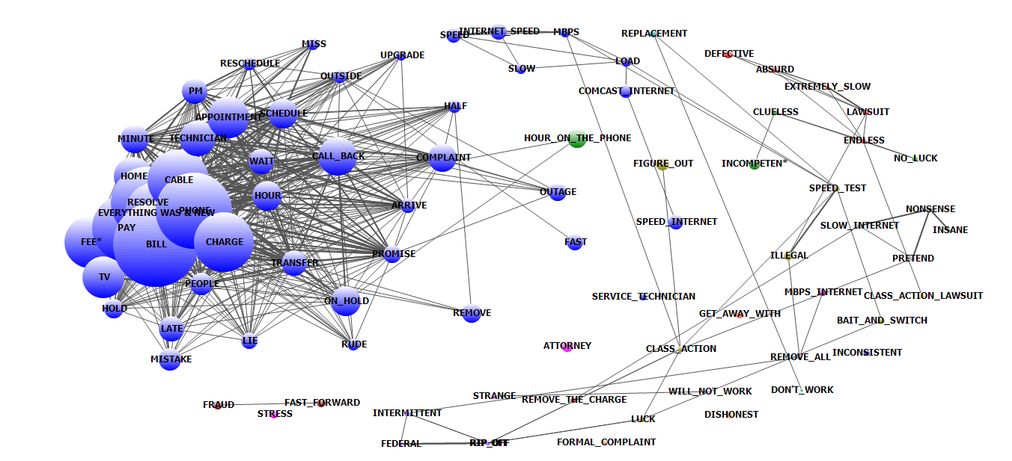
Filtered for Total Words > 300 and Who Mentioned Cancelled
Internet Speed
Service Technician Unsuccessful
This is what PCA Does
Call-in Customer Service Experience
Billing Dispute

Slide 28
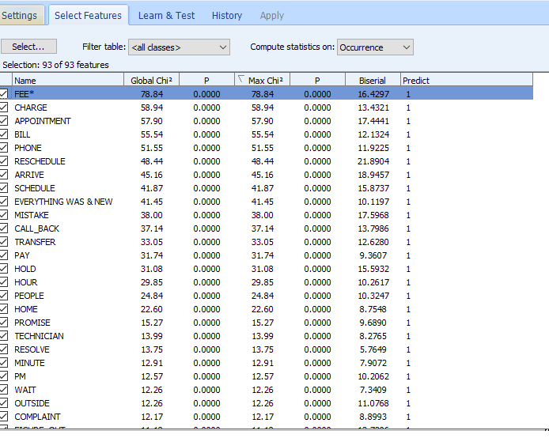
What Predicts Churn

Slide 29
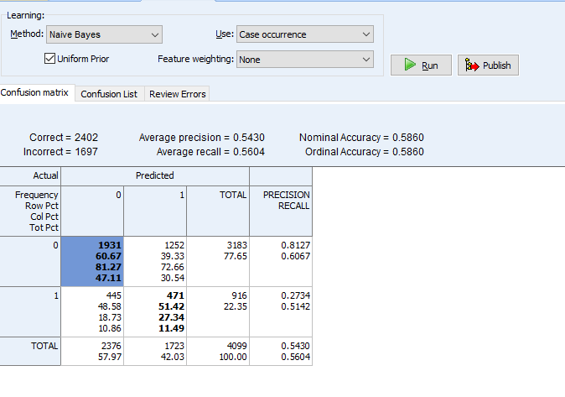
Accuracy is At 58%

Slide 30
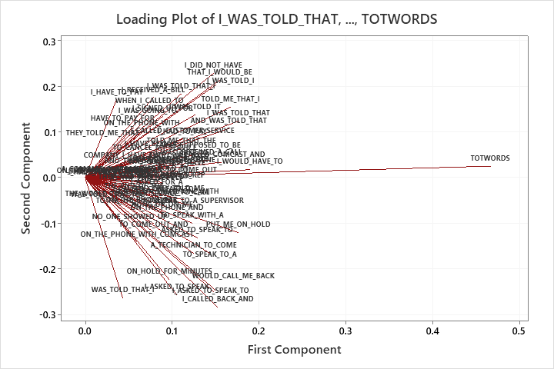
The Use of Phrases
Data Scientist or Psychologist?
Bad Phone Outcome
Bad Service Visit Experience
Bad Phone Experience Etiquette
Emotion

Slide 31
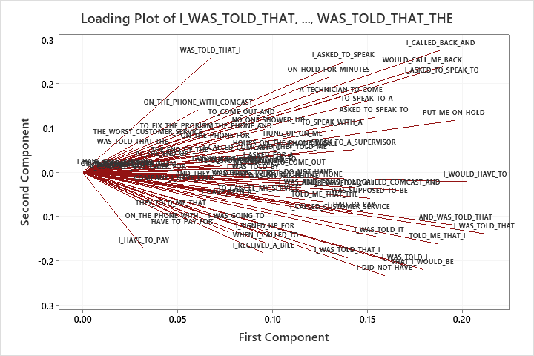
Billing Dissatisfaction

Slide 32
Comcast Recovery Needs to Address Both Seemingly Rational and Irrational Aspects of Consumer Behavior
Not just product attributes
Attribute 1
Attribute 2
∑ Attitudinal Beliefs
Attribute k
Intention to Cancel
Actual Behavior
Person 1
∑ Normative Beliefs
Person 2
Person j

Slide 33
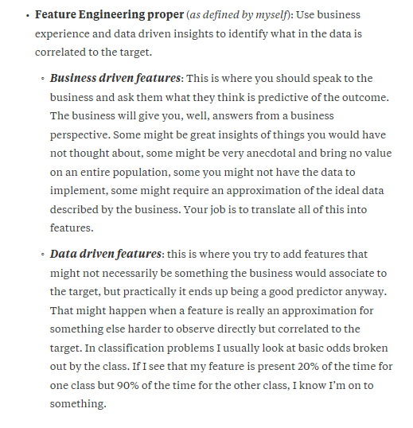
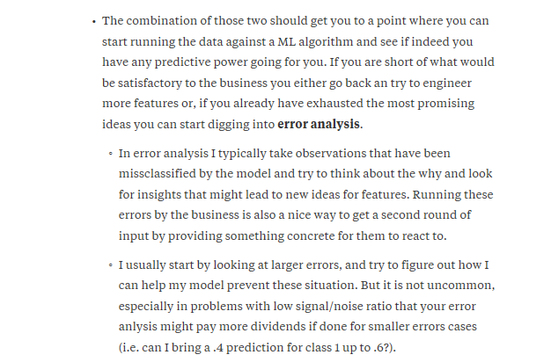
Feature Engineering
Article in Quora

Slide 34
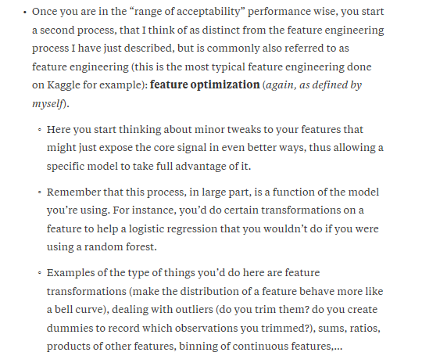

Slide 35
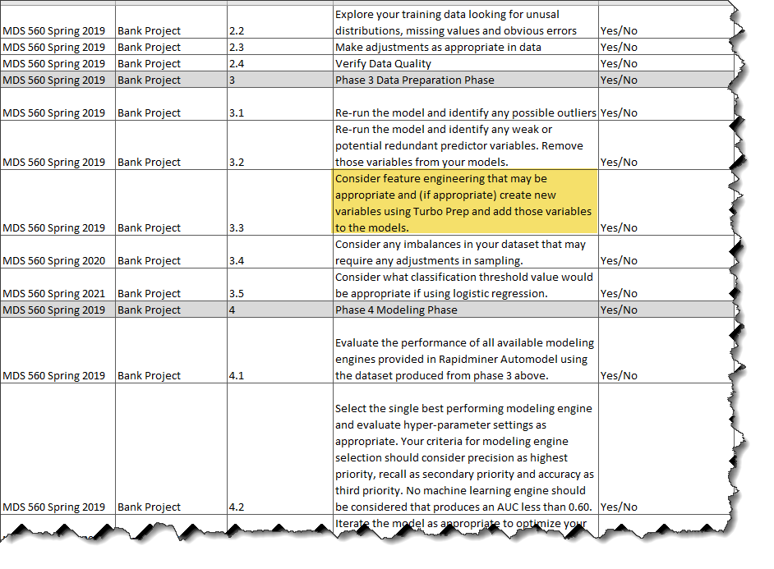
Feature Engineering Is a Part of Your Project Methodology

Slide 36
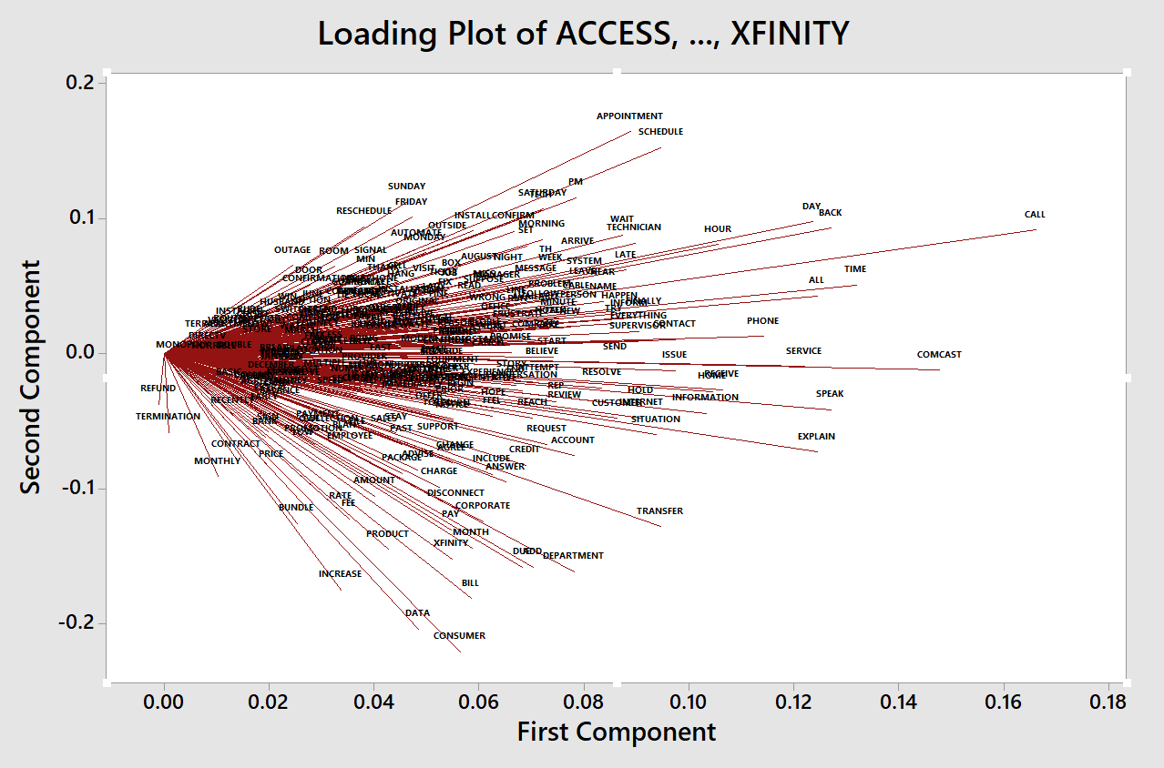
Filtered For Those Who Mentioned Cancellation (Churn)
Scheduling Problems with Service Technician, Waiting, Could Not Fix Problem
These are Technical Problems and Business Process Problems.
Triggering a Technical Task Force and Six Sigma
Called Customer Service But Had Difficulty Requiring Escalation and Wasting Time
Unsuccessful Dispute Resolution Regarding Fees

Slide 37
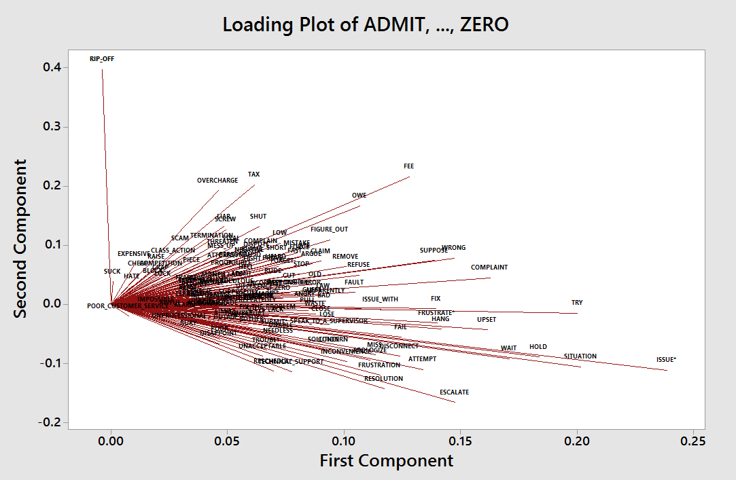
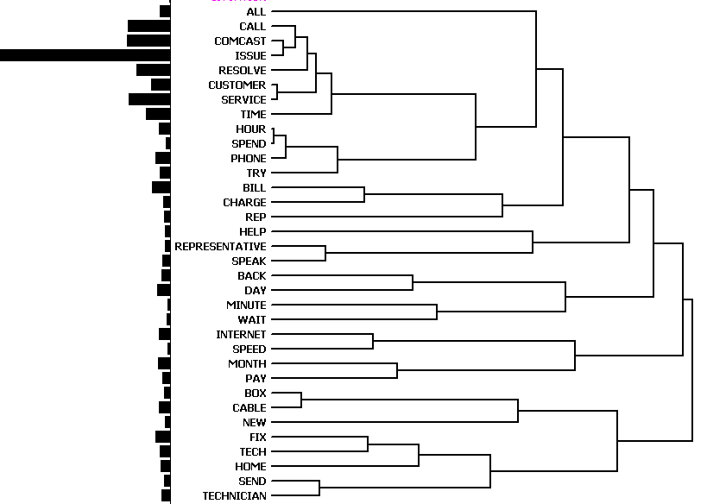
Discussion Board:
Principle Components
Factor Analysis
Topics Are Actionable

Slide 38
PCA and Dimensionality Reduction

Slide 39
X Matrix Predictors Only
N by M
N= number of records
M=Number of X Variables
https://www.youtube.com/watch?v=ZqXnPcyIAL8
https://www.youtube.com/watch?v=NUn6WeFM5cM
https://www.youtube.com/watch?v=7WqWoEKUdQY

Slide 40
M by M Square Matrix
PCA= Eigen Decomposition of Variance Covariance Matrix X^{T}X
W = a Set of Eigen Vectors (M by M)
λ= a set of eigen values
Matrix X^{T}X
Columns of W matrix called loadings, each column is a principle component, these are sorted in rank order according to lambda values.
T’s are called scores (N by M)
T=X W
T_{r} =X W_{r}
Because columns of W are ordered, we can truncate and select only most important number of columns r, W_{r} is an M by r matrix and T is now N by r

Slide 41
Let’s assume that the Comcast dataset contained two feature attributes—height and weight of respondent
We do not consider a label at this point—only features
weight
PCA Finds the direction of maximum variance
height

Slide 42
Discussion of Dimensionality Reduction Techniques
Principle Components Analysis=PCA
Consider the photography example…… https://www.youtube.com/watch?v=BfTMmoDFXyE

Slide 43
Let’s assume that the Comcast Exercise contained only two feature attributes—height and weight
PCA Finds the direction of maximum variance (PC1)
If we projected to only one dimension (say height), we would lose information as the variance would not be maximum as shown in a histogram.
PC1 is followed by second best PC2. This procedure gives best reconstruction. Just a rotation of axis. We don’t lose information.
We go from N to M dimensions and we can discard the dimensions with the smallest eigenvalues as they have less variance. As we discard we retain the material amount of information. EG if Eigenvalue =0, then no info.
This enables running regressions or classifications on smaller number of dimensions (features) without multicollinearity.
But we might lose the relationship with the label. Consider good predictor but with low variance.
PC1
weight
PC2
height

Slide 44
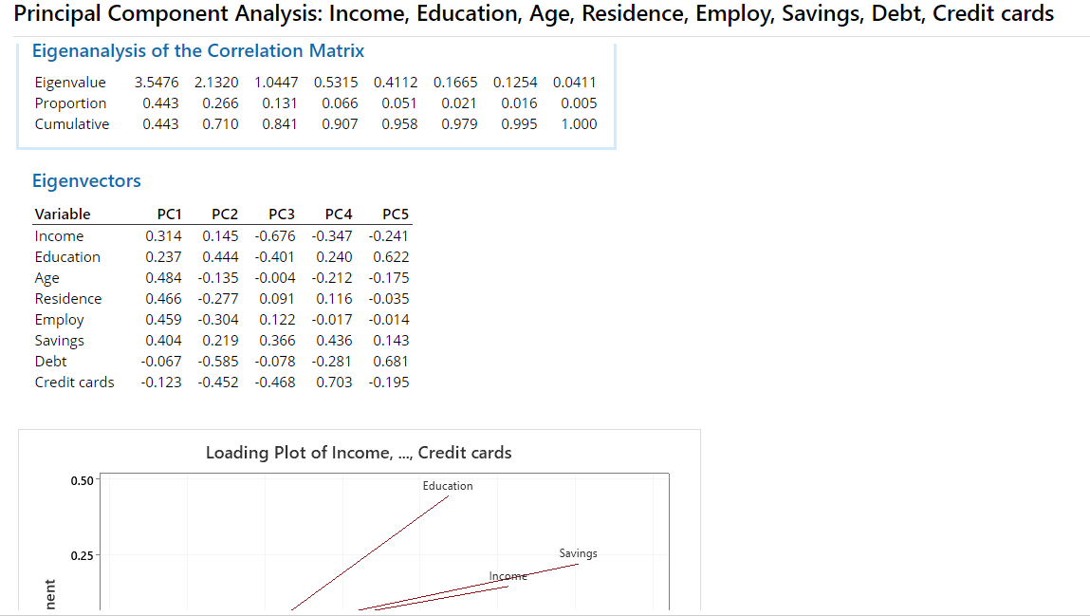

Slide 45
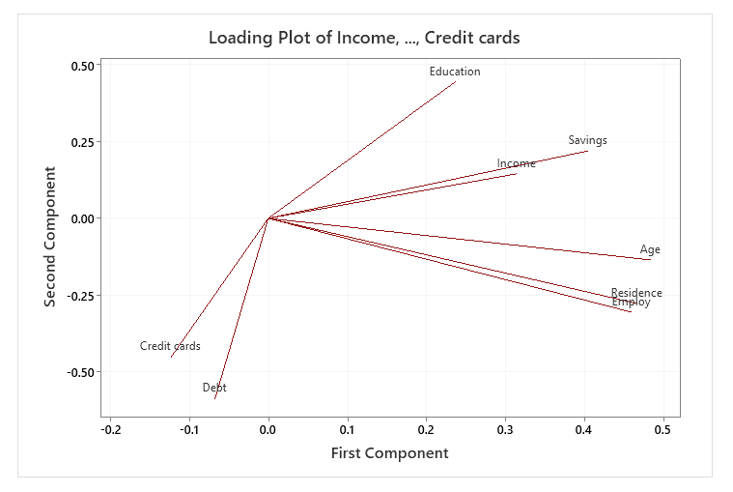
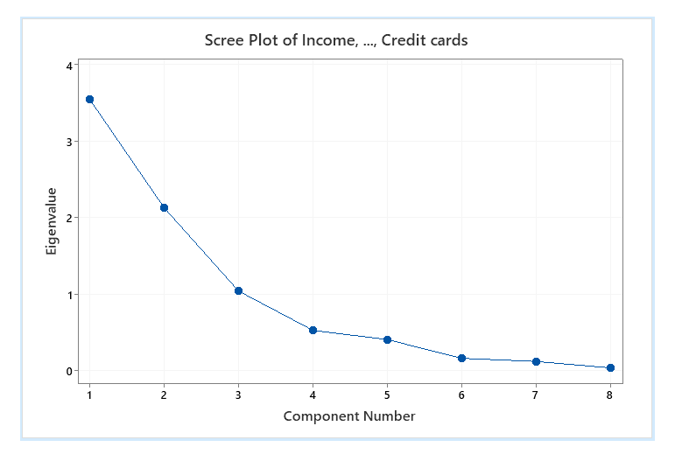

Slide 46
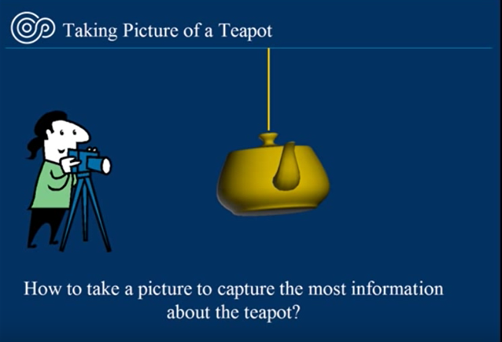
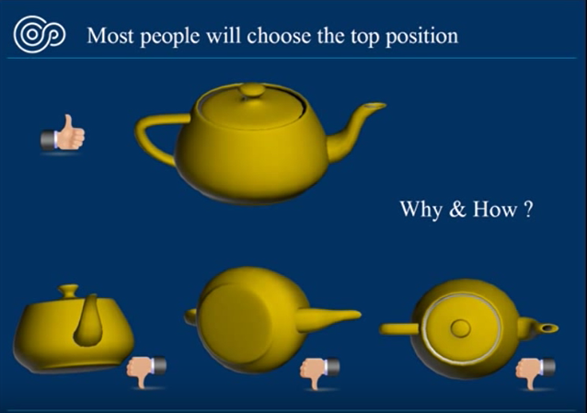
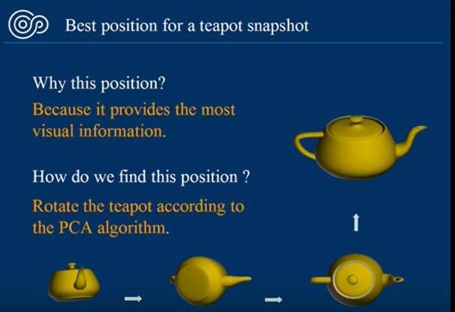
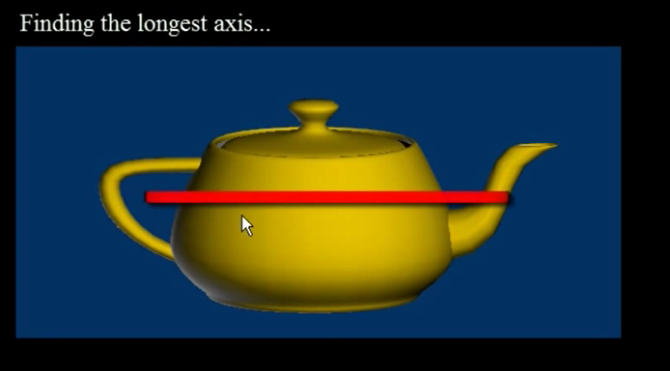

Slide 47
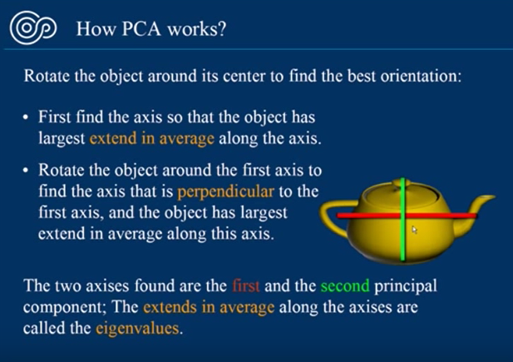
Also, when considering photography, it occurs in 3D space, but pictures are just 2D. Hence we are able to reduce a dimension without loosing the essential information. We do this by eliminating redundant information.

Slide 48
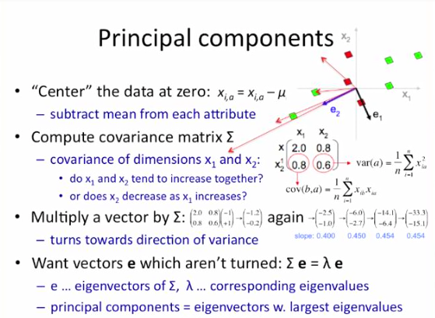
Actual Calculation Example Using a Simple Example of Two Dimensions
This comes from the LaGrangian optimization
https://www.bing.com/videos/search?q=pca+and+eigenvectors&&view=detail&mid=068E9B3CFC1492CFC136068E9B3CFC1492CFC136&&FORM=VRDGAR

Slide 49
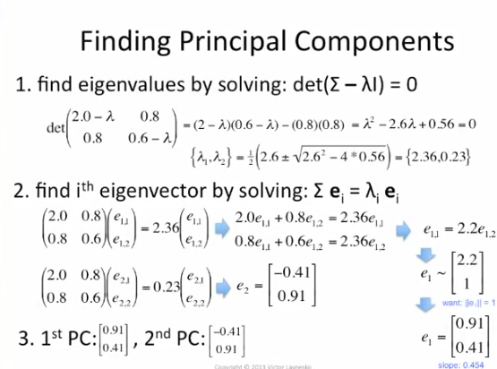
https://www.bing.com/videos/search?q=pca+and+eigenvectors&&view=detail&mid=CD771D4F15F81FD085E0CD771D4F15F81FD085E0&&FORM=VRDGAR

Slide 50
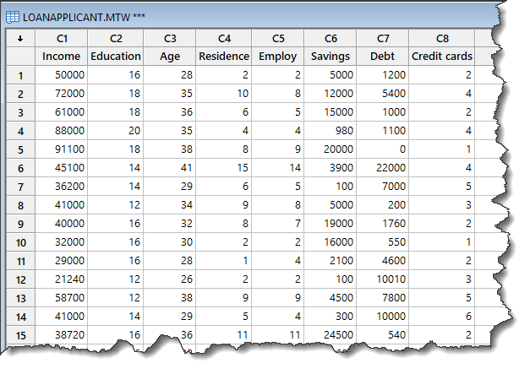
Minitab Example Loan Application With Eight X Variables
Let’s Walk Through Using Minitab.

Slide 51
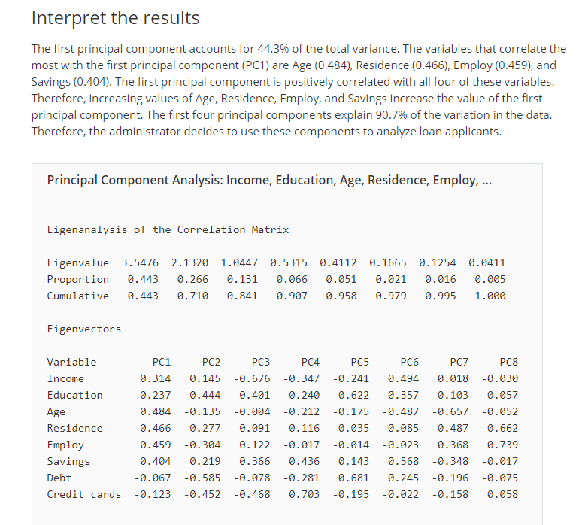

Slide 52
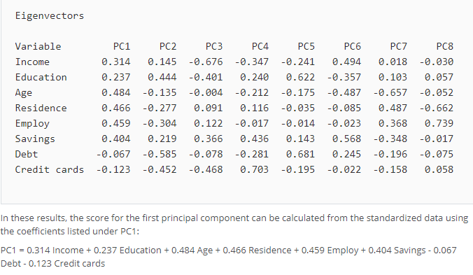
Allows Us To Create the Dimensions that Capture the Maximum Variance

Slide 53
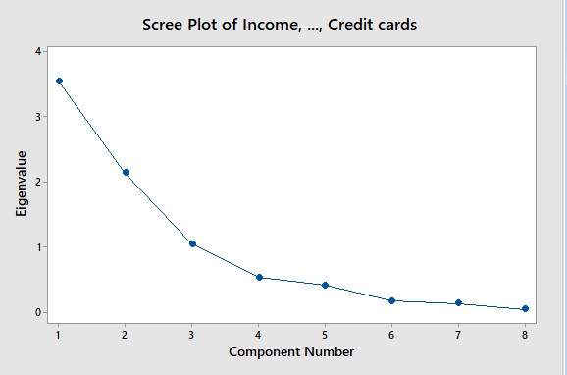


We Reduce Dimensionality By Just Using the First Two Principle Components for Our Models as X Variables

Slide 54


Now Dataset 7
Note we normalize

Slide 55

As Applied to Comcast Data

Slide 56


Slide 57


Slide 58
Project Management

Slide 59
Critical Use of Information for Feedback
Limits to human information processing (7 ± 2 bits of information at once (Miller 1956)).
Mental conflict (Cognitive Dissonance) occurs when beliefs or assumptions are contradicted by new information. When confronted with challenging new information, people often seek to preserve their current understanding of the world by rejecting, explaining away, or avoiding new information or by convincing themselves that no conflict really exists. (Festinger 1957)
Decision Traps Can Be Devastating to Projects And Are a Major Risk-Regardless of Methodology Chosen (Janis and Mann 1977)
Decision Traps are the Result of Cognitive Dissonance
Symptoms: Green-Green-Green Red syndrome
Loss of Management Confidence is a Well Documented Result
Notes:
The case study reinforces several key points to be made in the workshop:
Project environments are both stressful and information intensive. It is well documented that our ability to process information is limited to 7 ± 2 bits of information at once (Miller 1956). Stress causes even additional cognitive constriction (Janis and Mann 1977). Yet, vigilant Project Management decision making requires the full use of all available information.
Once a project manager and project team make a “public” commitment to achieve a challenging objective such as scheduled go-live date, psychological biases kick in that can cause them to ignore or reject new information that point to the contrary. This phenomenon, known as decision traps, can lead to misrepresentation in project reporting that delays the recognition of serious emerging risks on a project until it is too late to recover.
Mental conflict (Cognitive Dissonance) occurs when beliefs or assumptions are contradicted by new information. When confronted with challenging new information, people often seek to preserve their current understanding of the world by rejecting, explaining away, or avoiding new information or by convincing themselves that no conflict really exists.
To offset these information challenges in a project environment, we use recurring project team feedback to uncover important insights to not only emergent technical issues but also to emergent project management process problems as well. The raising of both technical issues and project management process concerns creates cognitive dissonance which is channeled to drive action towards prevention and correction.
Weekly Voice of the Team (VOT) surveys probe the confidential and candid insights of the entire project team and stakeholders throughout the project life cycle. The continual collection of diverse insights from stakeholders focuses upon the identification and follow-up of both project-specific technical risks as well as benchmarked project management process risks. It is confidential survey that enables team members to safely vocalize concerns about emergent issues and/or project management process concerns.
Although the Forecasting Project case study addresses a single, specific project only, the events described are generalizable to almost any complex technology project and especially to those requiring a targeted return on investment

Slide 60


Slide 61


Slide 62


Slide 63


Slide 64

The CRISP-DM Project Methodology

Slide 66

Notes:
A Challenge for the Project Manager is Making Open Decisions Visible
Equally Challenging is Managing the Mounting Complexity When Multiple Decisions Emerge Simultaneously.

Slide 67

Waterfall or Agile Project Life Cycle
Can We Also Mechanize the Managing Quality (Cost of Non Conformance) Using Milestone for Go No-Go Decisions.
Cycle 1
or
Phase 1
Cycle 2
or
Phase 2
Cycle 3
or
Phase 3
Cycle 4
or
Phase 4
Ready for
Cycle 2
Ready for
Cycle 3
Ready for
Cycle 4
Team Sentiment; Wisdom of the Crowd

Slide 68

Events in a Waterfall or Agile Project Life Cycle
Events
Key Deliverables
Work Streams
Quality and Completion Criteria
68

Slide 69

How Problems and Risks “Emerge” on Projects
Time
Problems, Emerge, Grow and Fester

Slide 70

Reporting for Quality Gate/Stage Gate Reviews
Sufficiency Criteria met?
Consider Exceptions in the Go-No Go Decision
How Do We Stay Ahead of the Emergent Problems?

Slide 71

This Kind of Report is Foundational. We are Using Data Science to Provide Information Gain to Support Improved Quality Management, Risk Management and Decision Making

Slide 72

Methodology Review of the Final Project

Slide 73


Slide 74


Slide 75


Slide 76


